Slide 1
Mobile Application Development
Introduction

Slide 2
Course Outline
Introduction to mobile application development
Types and examples of mobile applications
Android stack
Application life cycle
Application building blocks
Introduction to XML
Input controls
Application resources
Data adaptors
Data storage and retrieval

Slide 3
Terminologies
Mobile
Application
Mobile service
Mobile applications development
IDE
Mobile Platform
Mobile Applications Frameworks

Slide 4

Mobile Device
Mobile means “to move”
“able to move freely or easily”
“able or willing to move freely or
easily between occupations, places
of residence and social classes”

Slide 5


Mobile Device
Mobile Device refers to
portable, handheld communications
device connected to a wireless
network that allows users on move to
make voice calls, send text messages
and run applications.

Slide 6
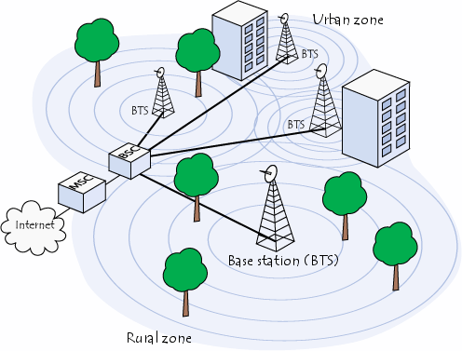
Mobile Network
A mobile Network refers to a cellular network or a communication network where the last link is wireless.
The network is distributed over land areas called cells, each served by at least one fixed-location transceiver, known as a cell site or base station. This base station provides the cell with the network coverage which can be used for transmission of voice, data and others.
The mobile switching station center (MSC) is a 2G core network element which controls the network switching subsystem elements.

Slide 7
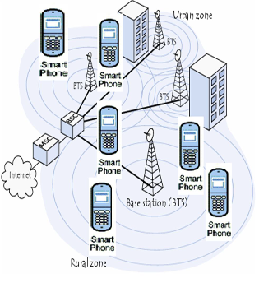
Mobile Station
A mobile station (MS)
comprises all user equipment and software needed for communication with a mobile network.
For example, a mobile phone installed with calling and SMS applications.

Slide 8
Mobile Service
Mobile service refers to a provision that is provided though mobile devices. Examples are:
1. Short Messaging service: Provision of text messages to mobile phones from the Internet or from other mobile devices. Usually limited to 160 characters.
2. Multimedia Message Service (MMS): A media-rich extension of SMS, which allows picture, sound or low-quality videos to be sent on a wireless network.
3. Unstructured Supplementary Service Data (USSD) services are initiated by the user, who enters a code on the mobile device and then sends that as a request to the network.

Slide 9
Application
Application refers to software that is developed specifically for smartphones and other mobile devices. Also known as an app.
These applications can be categorized into three types:
1. Native applications : pre-installed on phones during manufacturing platforms (Native apps)
2. Web Applications: Delivered using server-side or client-side processing (e.g. JavaScript) to provide an "application-like“ experience within a Web browser.
3. Hybrid apps : Native apps that combines elements of both native and Web applications.

Slide 10
Mobile Application Development
Mobile application development refers the act or process by which
application software is developed for mobile devices,
Before developing a mobile application, the following factors needs
to be considered
1. Choosing the mobile platform to build the application for.
2. Familiarize with the application framework for that platform. Mobile application frameworks. That is, set of class libraries that provide developers an interface to build applications.
3. Know the specifications of the device you will be developing the application for. Eg minimum speed, memory, screen size
4. Explore available tools at hand and determine which will best help in developing the applications. e.g. available emulators that can be used to simulate mobile devices on desktops during testing of applications

Slide 11
Mobile Application Development
Examples of important choices
1. If you want apps that work across multiple platforms, mobile web apps are a better option.
2. If you want apps that access the device’s camera or microphone, native apps are a better option.
3. If security is important, mobile web apps are a better option.
4. If you want to sell your apps, native apps are a better option.
5. If you want apps that integrate with existing systems and databases, mobile web apps are a better option.

Slide 12
Integrated Development Environments(IDEs)
Integrated development Environments(IDEs) refers to a set of developments tools that give a window interface to edit/compile/run or view the output of a mobile application
They can also track projects and help generate code for user interface components
They can be categorised into two categories:
1. Open IDEs are freely available IDEs e.g. Eclipse and Android Studio for Android).
2. Proprietary IDE that requires subscription fees or licenses examples: Xcode for iOS and MS Visual Studio for windows phone.

Slide 13
Integrated Development Environments (IDEs)
IDEs consists of the following tools:
1. Program Editor
2. Compiler
3. Testing tools e.g. Emulator test management, unit tests)
4. Debugging tools
etc.

Slide 14
Mobile applications Platform
Mobile platform is a software environment that allow software and services to be run on mobile devices (Fling 2009).
It is also called mobile operating system (Mobile OS).
Examples of mobile platforms include:
  Android.
  iOS
  Windows Mobile
  Symbian
  BlackBerry RIM
  Samsung Bada
  NB: Usually ‘mobile platforms’ and ‘mobile operating system’ are
  used interchangeably.

Slide 15
Mobile application frameworks
Mobile application frameworks are set of class libraries that provide developers an interface to build applications.
Examples are:
  1. Java ME
  2. Cocoa Touch
  3. Android SDK
  4. WebKit.
  Applications are built using application frameworks on the
  given platform.

Slide 16
Motivations of using Mobile device(advantages)
1. It is potentially available to serve everywhere and any time since it is portable.
2. They have been Interwoven into daily life . E.g. They are used as utility when performing almost every activity such as work, play, study etc.
3. It represents the user .e.g. through phone number.
4. Can be used to develop interactive applications that enables users to communicate with others through feedback channels e.g. social media.
5. Allow users to access multi-modal content such as video and audio clips.
6. Content in the same file can be updated dynamically through copy and paste features.

Slide 17
Mobile Application Development Challenges
No “standard” device. That is , there is no device for all platform (iOS, Windows Phone devices)
Low bandwidth input in most cases
Limited screen size
Unreliability in connectivity
Small keyboard

